Slide 1
Deep Learning for plant identiﬁcation using vein morphological patterns
Guillermo L. Grinblat, Lucas C. Uzal, M´onica G. Larese and Pablo M. Granitto

Slide 2
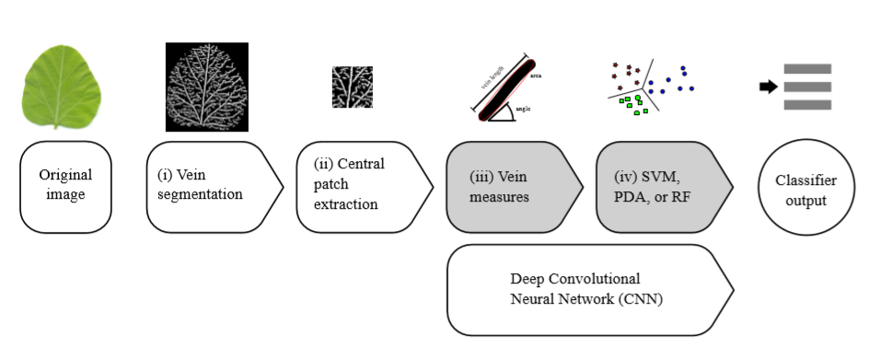
1. Pipeline
A central patch (100x100 pixels) of the binary image is cropped and the rest of the image is discarded
Binary image

Slide 3
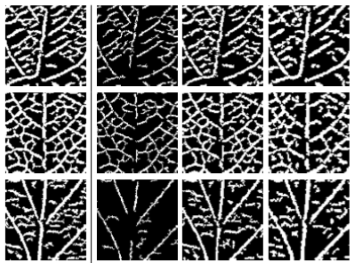
2. Central pacth
S1 were be scaled 100% (no resize), 80%, and 60% by (hit and miss algorithm). The processed images were resized back to the original size
S2
S1

Slide 4
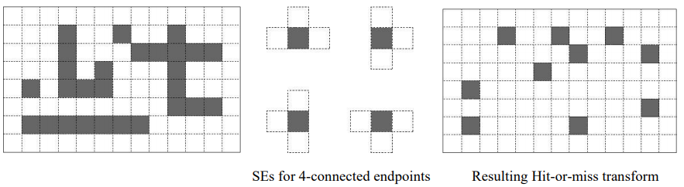
2. Central pacth

Slide 5
3. Vein measures
Total number of veins, total number of nodes, mean vein width, among others

Slide 6
3. Vein measures
52 features for one patch / sample
208 features for 4 patchs / sample
Using LEAF GUI

Slide 7
3. CNN

Slide 8
3.1 Datasets
For the S1 setup, one channel (100 x 100 x 1)
For the S2 setup, four channels (100 x 100 x 4)
422 images correspond to soybean leaves, 272 to red bean leaves and 172 to white bean leaves (12 days grow)
The images were acquired using a standard ﬂatbed scanner (Hewlett Packard Scanjet-G 3110) at a resolution of 200 ppi

Slide 9
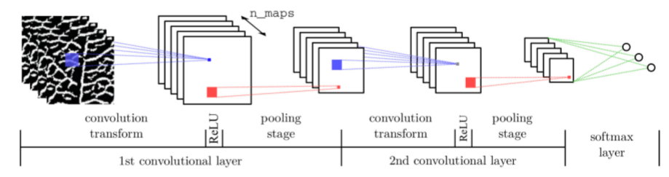
3.2 Model

Slide 10
3.3. Training
The parameters were optimized using stochastic gradient descent (SGD) over a training set using minibatches of 20 samples.
Dropout: 50 %
Learning rate: 0.01

